Slide 1
The Elaboration Likelihood Model

Slide 2
The Problem
People don’t necessarily pay attention to (or think about) good messages.
How do we know if our audience is going to process our message?
What determines whether they think about the arguments in a message just a little bit or a whole lot?
How do we know when we should use flashy “image”-based appeals and when we should use serious evidence for what we’re arguing?

Slide 3
Today’s Lecture
Cover the elements of the Elaboration Likelihood Model.
The types of information we use when we process messages.
The two cognitive routes we use to process messages.
The conditions under which we use each route.
Talk about how it applies to persuasive messages.

Slide 4
Question
How can you do well on a job interview? What are the “tips and tricks” you’ve heard? What do you know from common sense?
We will take the interviewer’s perspective so we can understand how they will process our messages.

Slide 5

Overview of the Elaboration Likelihood Model
Developed by Petty and Cacioppo in 1986.
The model that suggests we process persuasive messages in two different ways:
Central route
Peripheral route
We may use both simultaneously, but we tend to favor one route over another depending on a number of factors.

Slide 6
Definitions
Elaboration:
Issue-relevant thinking.
Cognitive attention.
Likelihood:
The probability that you will spend time thinking about the object of the persuasive attempt.
Central route of persuasion:
Involves high elaboration.
In other words, lots of issue-relevant thinking.
Peripheral route of persuasion.
Involves low elaboration.
In other words, little rational thought is used.

Slide 7

The Central Route
When elaboration is high, we pay a great deal of attention to message arguments and we think about lots of things that might be relevant to the message.

Slide 8
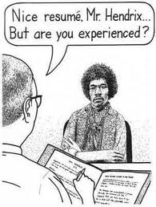
Central route is used when:
The receiver’s degree of involvement is high.
Involvement: Relevance to the receiver. Perception that issue has a high impact on receiver. High level of commitment/investment.
There are multiple sources giving multiple messages.
The receiver has a high cognitive capacity.

Slide 9
Central route cont.
Even if we can get people to elaborate, there is no guarantee that they will LIKE the message.
To maximize positive feelings toward your message:
Include proattitudinal arguments (things the audience already agrees with).
Use language that your audience understands (translate technical terms into appropriate language for your target).
If they don’t understand you, they’ll use the peripheral route.
Use strong arguments
Good evidence
Larger number of strong arguments (quality + quantity)

Slide 10
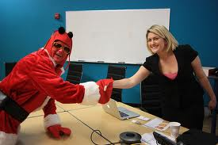
The Peripheral Route to Persuasion
When elaboration is low, receivers use cognitive shortcuts called heuristics (also called “heuristic cues”) to decide whether or not to comply.
Peripheral route is used when:
The receiver’s degree of involvement is low.
There is a single source for information. (This creates a greater reliance on heuristic cues.)
The receiver has lower cognitive capacity.
Highly distracted, cognitively overloaded, lower in need for cognition.

Slide 11

Peripheral route cont.
Types of heuristics used to process messages when using the peripheral route:
Source is high in credibility
Attractive, likable source
Consensus among other receivers of the message
Number of arguments (or length of message) rather than content
Use of emotion to persuade
The information used in peripheral processing is inherently easier for our brains to process (than facts, evidence, reasoning).

Slide 12
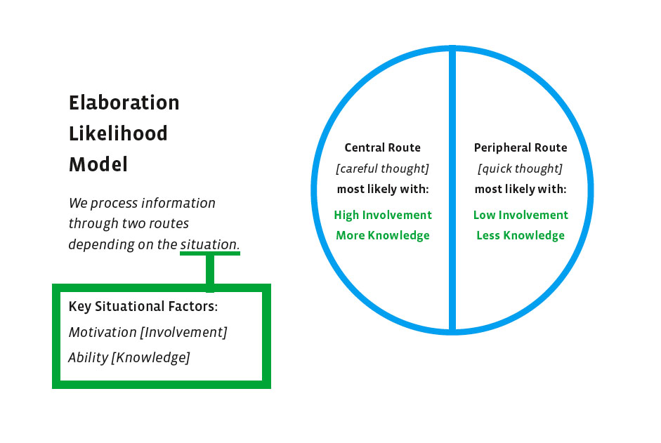

Slide 13
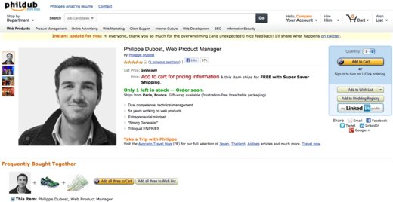
Is Phillipe Dubost’s site effective?
http://www.phildub.com

Slide 14
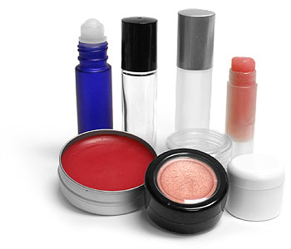

Matching route to the situation
Some products/services are not as well suited to messages that would rely on central route processing.
Cosmetics/personal grooming products
Clothes, accessories (image-based products)
Hiring seasonal/temporary hourly workers
On the other hand, some products are not as well suited to messages that would rely on peripheral route processing.
Real estate, computers, furniture (or hiring a decorator)
Hiring a CEO

Slide 15

Analyze this!
Compare and contrast the following two video clips. Which relies on central route processing and which relies on peripheral route processing?
Trapped (NZ Transportation Association):
http://www.youtube.com/watch?v=zdRZhfWFPHE&list=PLVvSkj_tpJEFZxaiY_VceJX5UGFh_BN7m
Legend (New Zealand Police and Land Transport):
http://www.nzta.govt.nz/about/advertising/drink-driving/legend.html
(Both clips are from the New Zealand Police and Land Transport.)

Slide 16
Argument strength
How strong were the arguments in the PSAs?
Argument strength is in the eye of the audience.
What YOU think is a strong argument is completely irrelevant.
You have to know your audience well in order to create “strong” arguments.
How was emotion used in the PSAs? How does that affect which route is likely to get used to process the message?

Slide 17

Cognitive capacity
Audience members’ cognitive capacity will affect how they process a message.
Cognitive capacity is a person’s ability to think about arguments.
Need for Cognition (NFC) is a person’s interest in engaging in effortful thinking.
Cognitive capacity is also affected by how much distraction is in the environment and how much stress a person is under.
And sometimes, we just feel cognitively lazy. Our brains get tired if we’ve exerted a lot of effort recently.

Slide 18
Need for Cognition
I can’t tell you about your overall cognitive capacity, but you can get one piece of the puzzle by completing a short questionnaire about Need for Cognition.
Answer each question on a scale from 1 to 5 (1 = “not at all like you” to 5 = “Very much like you”).
A few of the questions are reverse-coded. When you’re all done answering the questions, you’ll go back and change a few answers according to the instructions.
Then, you’ll total your points.

Slide 19
Need for Cognition Scale (Cacioppo, Petty, Feinstein, & Jarvis, 1996)
1= extremely uncharacteristic of you (not at all like you)
2= somewhat uncharacteristic
3= uncertain
4= somewhat characteristic
5= extremely characteristic of you (very much like you)
1. I would prefer complex to simple problems.
2. I like to have the responsibility of handling a situation that requires a lot of thinking.
3*. Thinking is not my idea of fun.
4*. I would rather do something that requires little thought than something that is sure to challenge my thinking abilities.
5*. I try to anticipate and avoid situations where there is a likely chance I will have to think in depth about something.
6. I find satisfaction in deliberating hard and for long hours.
7*. I only think as hard as I have to.
8*. I prefer to think about small, daily projects than long-term ones.
9*. I like tasks that require little thought once I’ve learned them.
10. The idea of relying on thought to make my way to the top appeals to me.
11. I really enjoy a task that involves coming up with new solutions to problems.
12*. Learning new ways to think doesn’t excite me very much.
13. I prefer my life to be filled with puzzles that I must solve.
14. The notion of thinking abstractly is appealing to me.
15. I would prefer a task that is intellectual, difficult, and important to one that is somewhat important but does not require much thought.
16*. I feel relief rather than satisfaction after completing a task that required a lot of mental effort.
17*. It’s enough for me that something gets the job done; I don’t care how or why it works.
I usually end up deliberating about issues even when they do not affect me personally.
Scoring:
Reverse responses to items: 3, 4, 5, 7, 8, 9, 12, 16, and 17
Then add up scores for all 18 questions.
Higher scores indicate a higher need for cognition.

Slide 20
Scoring the Need for Cognition Scale
Change the numbers you wrote in response to questions # 3, 4, 5, 7, 8, 9, 12, 16, and 17.
Change the numbers as follows:
1 5
2 4
3 stays the same
4 2
5 1
Now, add the numbers. Yes, you can use your cell phone. Score will be between 18 and 90.
Average score in one large study of students was 58. (In case you’re curious, mine was 76.)

Slide 21
Some Key Findings
Attitudes formed via central processing are more persistent and durable than attitudes formed via peripheral processing.
Increasing receivers’ perceived involvement in an issue can promote central processing.

Slide 22
Deciding what types of messages to use
Do you need a person to be thoroughly converted to your position?
Central route. Use messages with great arguments.
Do you need a person just to make a quick, one-time decision?
Peripheral route. Use attractive (or credible) source. Quantity over quality of arguments.
Do you need your audience to be resistant to competing positions/products/services?
Central route. Produces more enduring attitudes that resist change.
Is the person (audience) you’re talking to have a lot of ability and motivation to think about what you’re saying?
Central route. Don’t insult them with a lot of flash and little substance.
In interpersonal situations, assess whether the person is fully engaged (open nonverbals, thoughtful answers to questions).
If not, be charming and find common ground. If so, give them your best arguments.
Most people are cognitively lazy unless the issue is highly relevant.
Attend to peripheral route cues first but use as many strong arguments as you can generate.

Slide 23
